Slide 1
Dynamo Master Class - Monopoly
Dynamo for Revit
Dynamo for Revit Creating
Selecting
Floor By Outline
Geometry
Wall By Curve
Translation, Rotation, and Other Transformations
Remember Node
Revit Hierarchy
DesignScript Geometry Basics
Getting Elements By Category
Geometric Primitives
Getting Elements By Family Type
Select Faces
Vector Math
Getting Parameters
Curves: Interpolated and Control Points
Getting Set parameters
Surfaces
Move Families
Geometric Parameterization
Best Practices
Geometric Booleans
Reduce Complexity
Tune Up
Develop efficiently with Code Blocks
Lacing
Maintain Readability
Dynamo Import Export
Relational Database
Explain with Notes
Importing Geometry
Importing Excel
Null Strategies
Export CVS
Code Block Functions
Import Images
UI/UX
Dynamo Player
Data Shapes
Dictionaries
GitHub

Slide 2







Dynamo Master Class,
While Playing Monopoly
Sean Fruin
Company Logo
DIGITAL BUILT WEEK AMERICAS
JUNE 15-17, 2023 | DALLAS, TEXAS

Slide 3



Sean Fruin, Michael Kilkelly
DIGITAL BUILT WEEK AMERICAS
JUNE 15-17, 2023 | DALLAS, TEXAS
John Pierson

Slide 4
Digital Built Week Americas 2023
___________________________________________
Questions related to specific materials, methods, and services will be addressed at the conclusion of this presentation.
DIGITAL BUILT WEEK AMERICAS
JUNE 15-17, 2023 | DALLAS, TEXAS

Slide 5
Session Description
Learning Dynamo can be confusing for nonprogrammers, and mastering Dynamo can seem nearly impossible. Still, this class has the whole spectrum covered by teaching Dynamo using a topic almost everyone can understand, the game of Monopoly. This master class covers various topics the three expert presenters discussed as they share the code and their collaborative process. These topics include Revit data structure, rendering beautiful Revit visuals, creating rotating Revit families, building geometric systems, and authoring code best practices. Whether you are a beginner or an expert, this class has practical tips and tricks. Be sure to stop by and check out this fantastic demonstration of just how far Revit and Dynamo can go and get your hands on the latest version of America's favorite board game, Monopoly.
Learning Objectives
Deconstruct and program the game of Monopoly.
Discover the key Dynamo functionalities.
Learn best practices for authoring Dynamo Scripts.
Build relationships between Revit’s elements to create parametric Systems.
DIGITAL BUILT WEEK AMERICAS
JUNE 15-17, 2023 | DALLAS, TEXAS

Slide 6




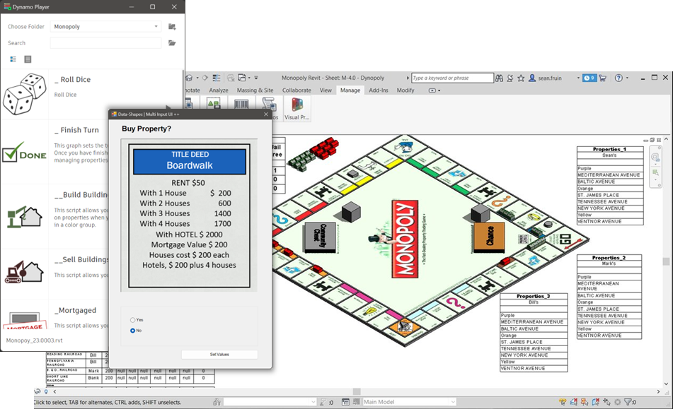









Master Class
Redeem
While Playing
Mortgage

Slide 7

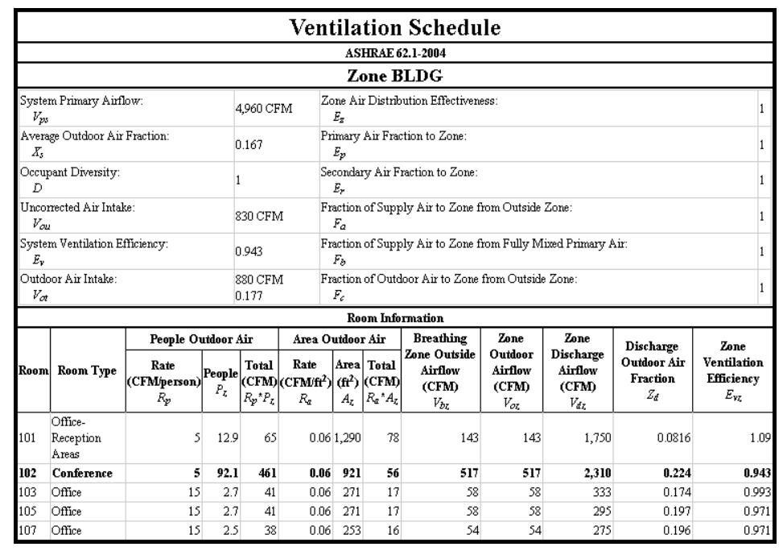
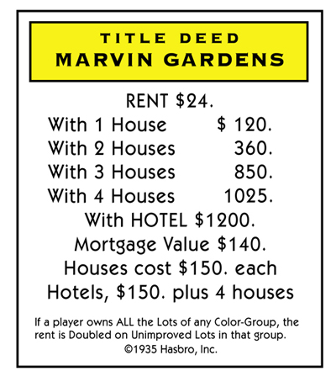

Dynamo Master Class While Playing Monopoly
Data Look Ups Tables

Slide 8
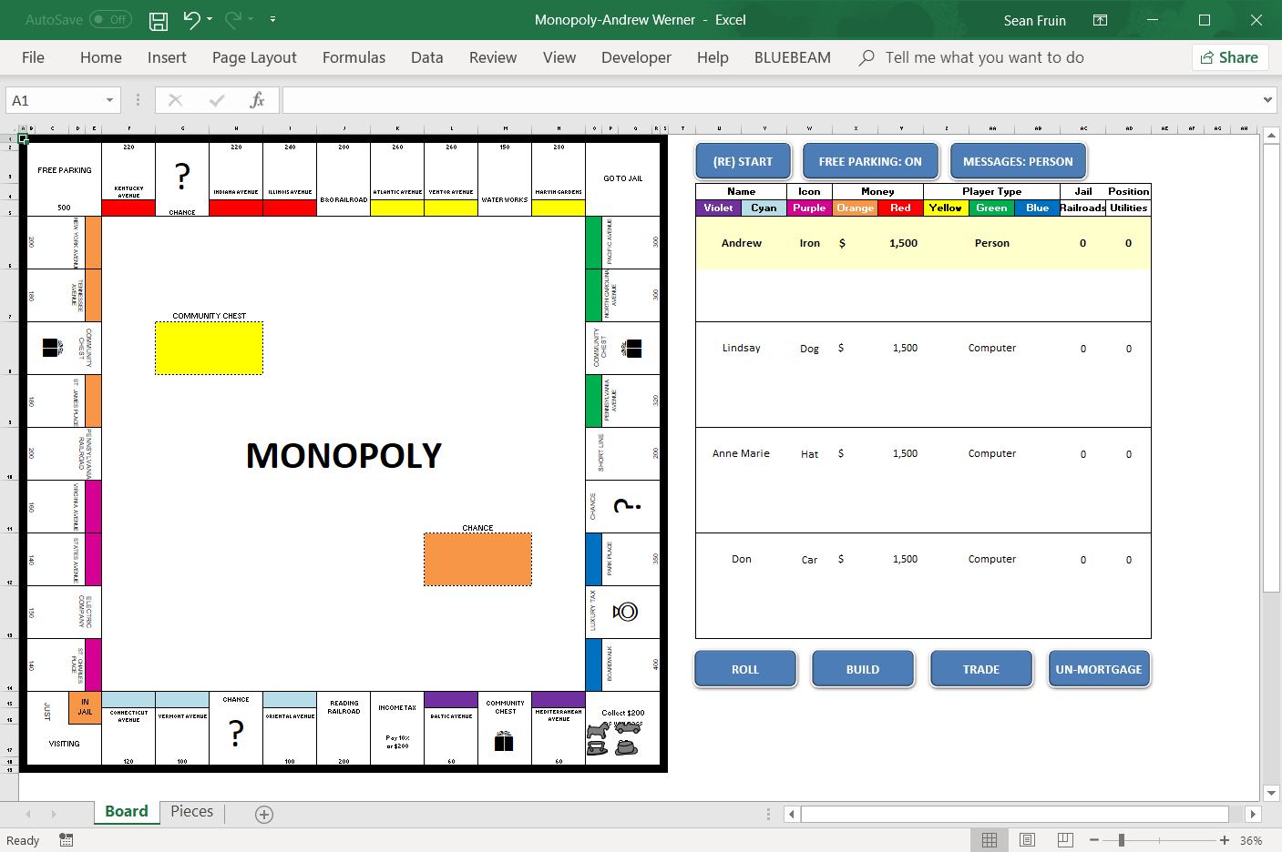
Dynamo Master Class While Playing Monopoly
Data - Relational Data Base

Slide 9
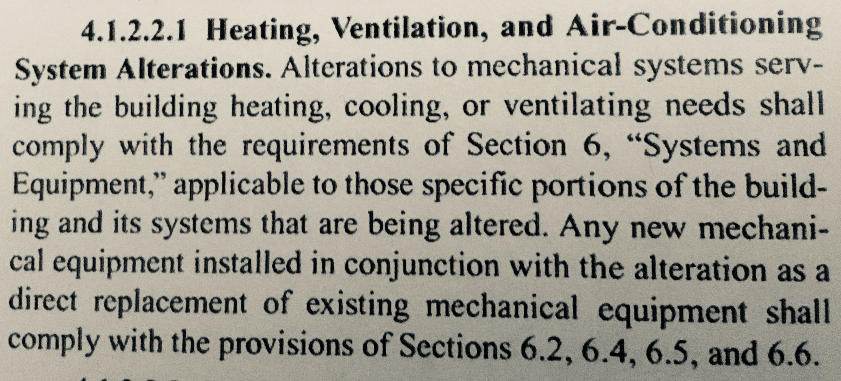
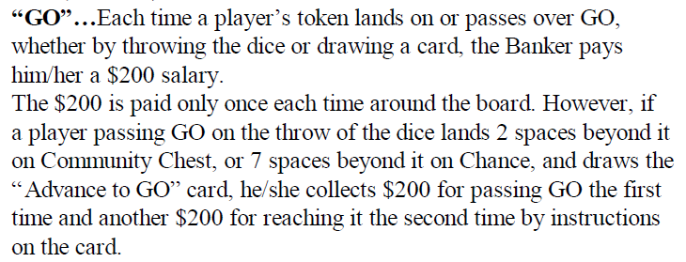
Dynamo Master Class While Playing Monopoly
Why – Build Code to Nodes
4.1.2.2.1 Heating, Ventilation and Air-Conditioning

Slide 10

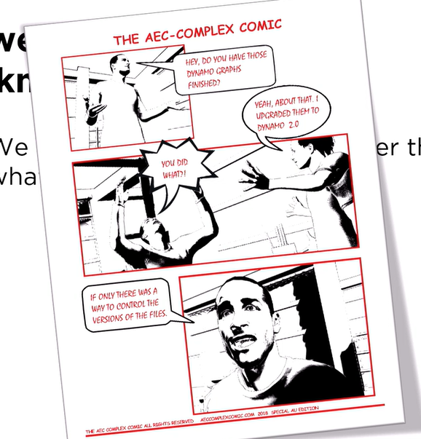
Dynamo Master Class – Monopoly
GitHub for Dynamo

Slide 11
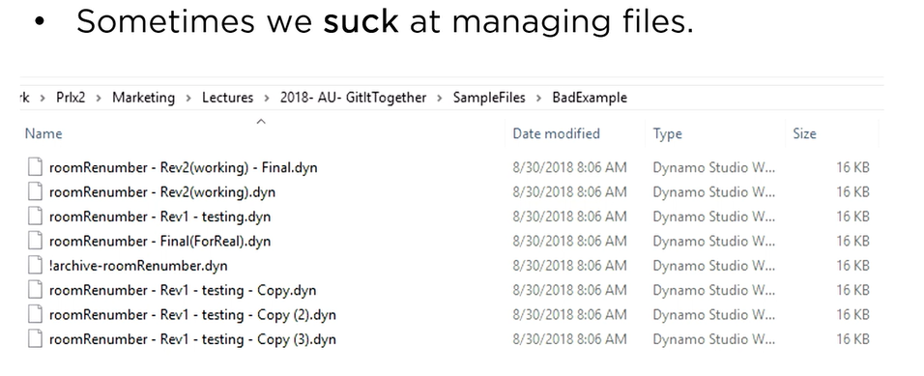
Dynamo Master Class – Monopoly
Why GitHub

Slide 12
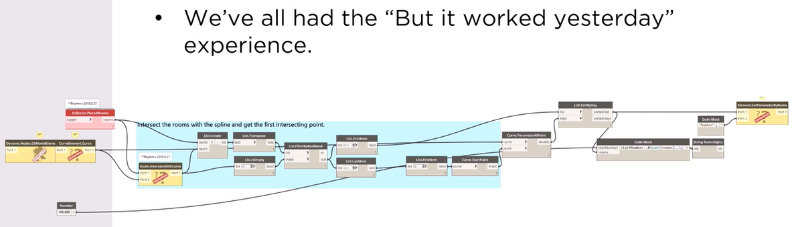
Dynamo Master Class – Monopoly
Why GitHub

Slide 13
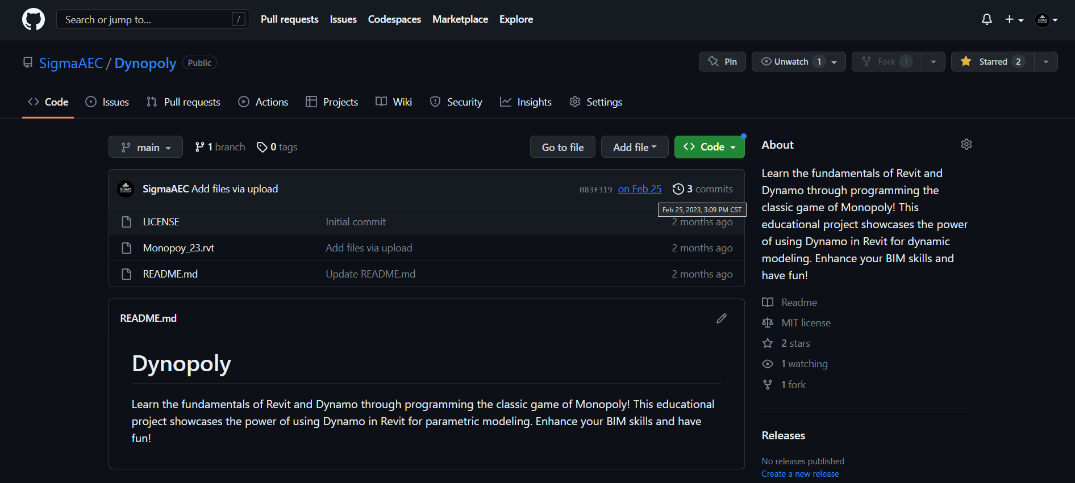
Dynamo Master Class – Monopoly
Why GitHub
https://github.com/SigmaAEC/Dynopoly

Slide 14







Dynamo Master Class – Monopoly
Why GitHub

Slide 15

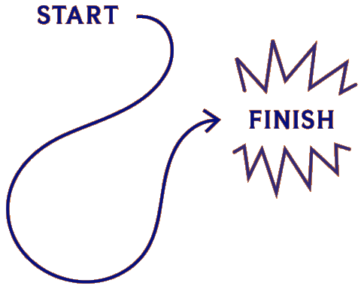
Dynamo Master Class – Monopoly
Script Development Process

Slide 16

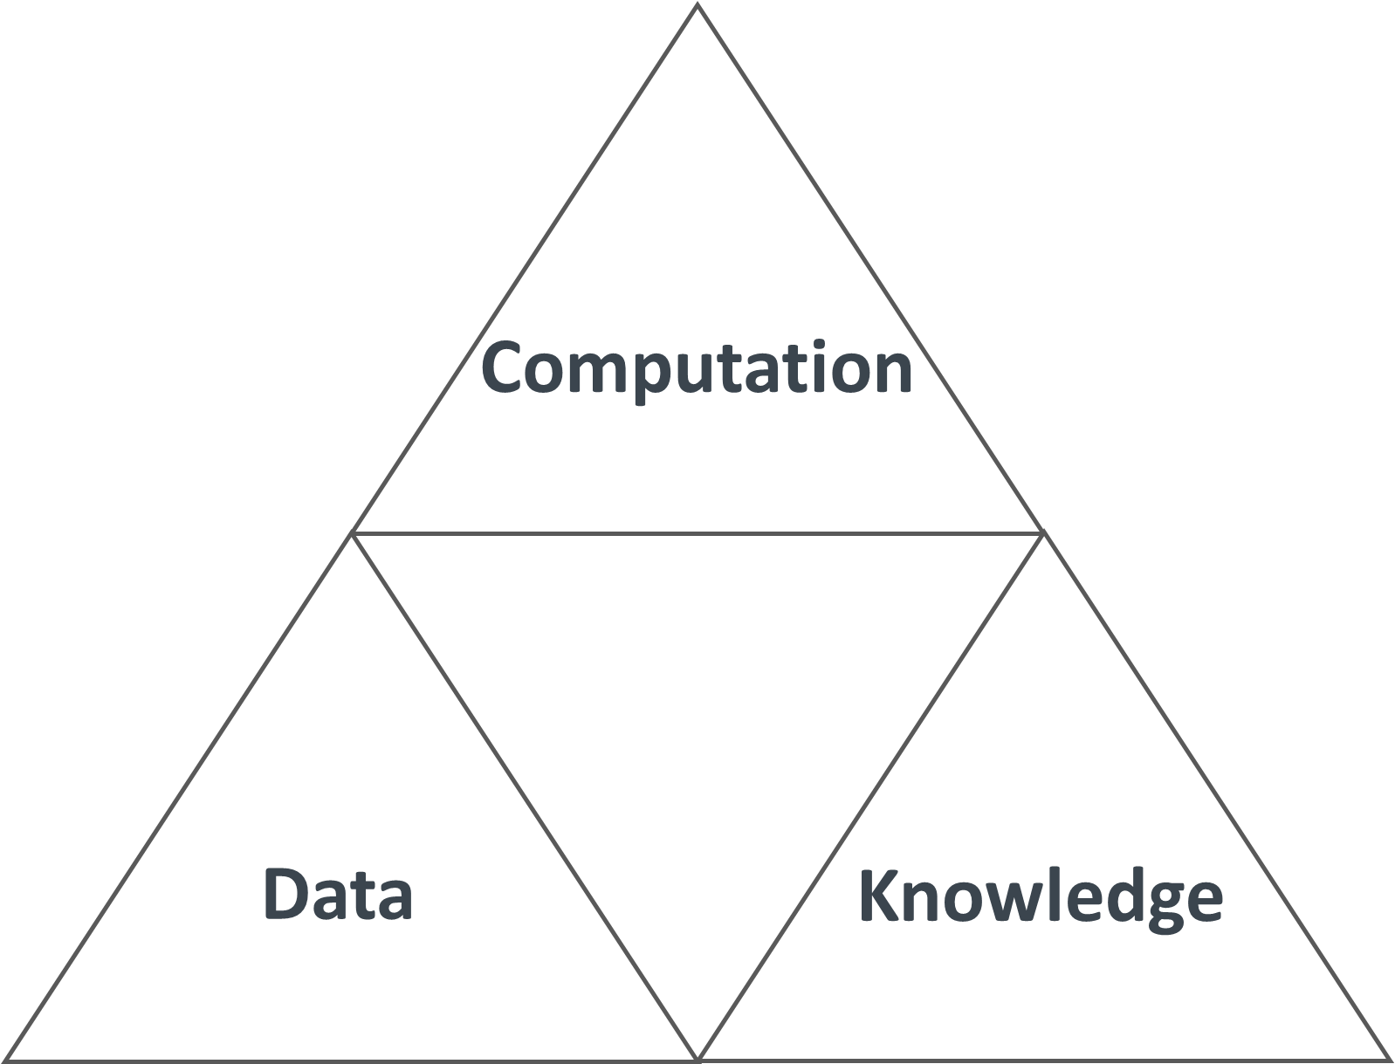
Script Development Process
Identify the Triforce
Computation
Data
Knowledge

Slide 17


Script Development Process
Knowledge

Slide 18
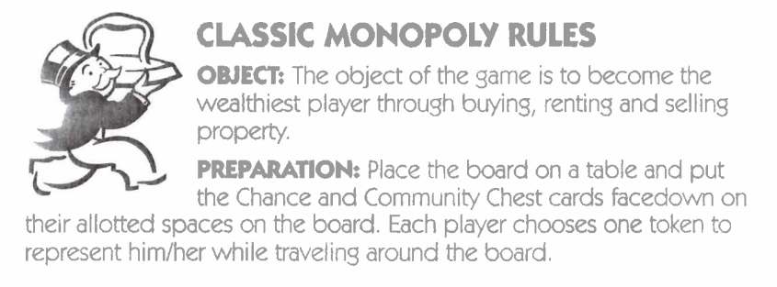
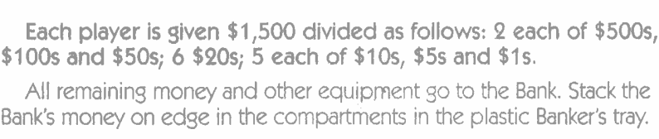
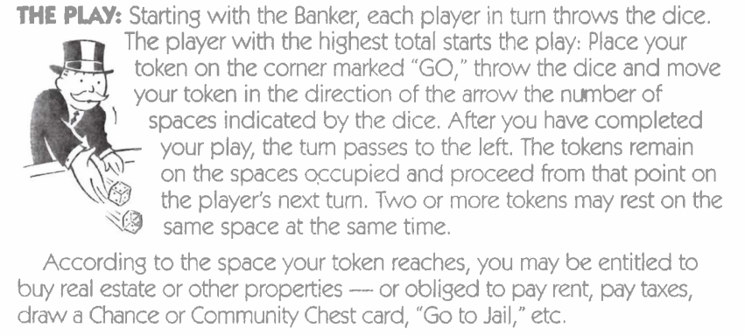
Script Development Process
Knowledge

Slide 19

Script Development Process
MosCow
Must-Have
Should-Have
Could-Have
Won’t-Have
Properties
Roll Dice
Move Players
Money Exchange
Jail System
Houses and Hotels
Community Chest & Chance Cards
Winner Determination
Customizable game rules
Multiplayer support
Sound effects and music
Trading System
Auction System
VR support
Visual Effect
Online Multiplayer
Customizable game rules
Multiplayer support
Sound effects and music
Animation

Slide 20

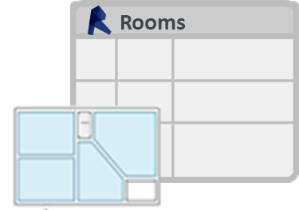

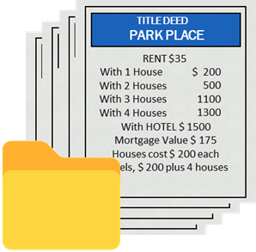

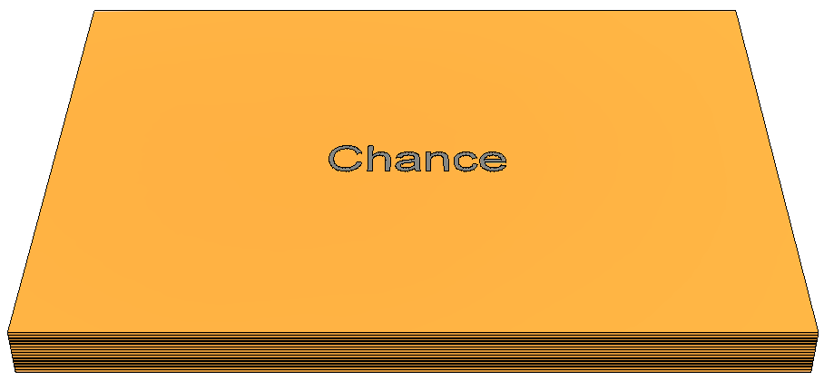







Script Development Process
Data – How?
Gameboard
2 dice
Tokens
32 houses
I2 hotels
Chance cards
Community Chest cards
Title Deed cards
Play Money
Banker’s Tray
Generic Model
Generic Model
Generic Model
2 dice

Slide 21
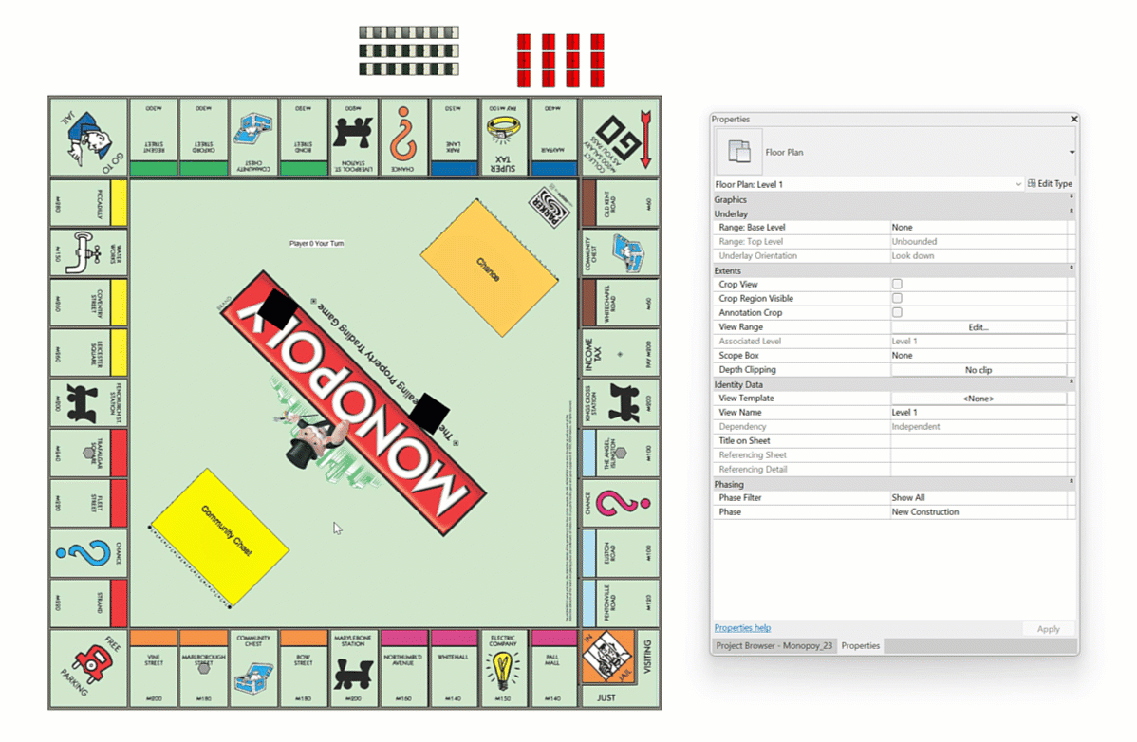
Script Development Process
Data – How?

Slide 22


Script Development Process
Data – Relational Database

Slide 23

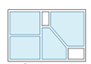
Script Development Process
Data – Board Spaces
Rooms
Parameters
Name | Type | Tool Tip
id
Name
isMonoply
IsMortgaged
Location

Slide 24
Script Development Process
Data – Rooms
Parameters
Name | Type | Tool Tip
id
Name
isMonoply
IsMortgaged
Location
Generic Model

Slide 25
Script Development Process
Data – Board Spaces
Generic Model
Parameters
Name | Type | Tool Tip
id
Name
isMonoply
IsMortgaged
Location
Generic Model
Notes:
Why - cache the results in the .dyn
Strings
Numbers
Solids
Points
Surfaces
'cannot store data of type'.

Slide 26

Dynamo Master Class – Monopoly
Chance Cards

Slide 27

Script Development Process
Computation

Slide 28
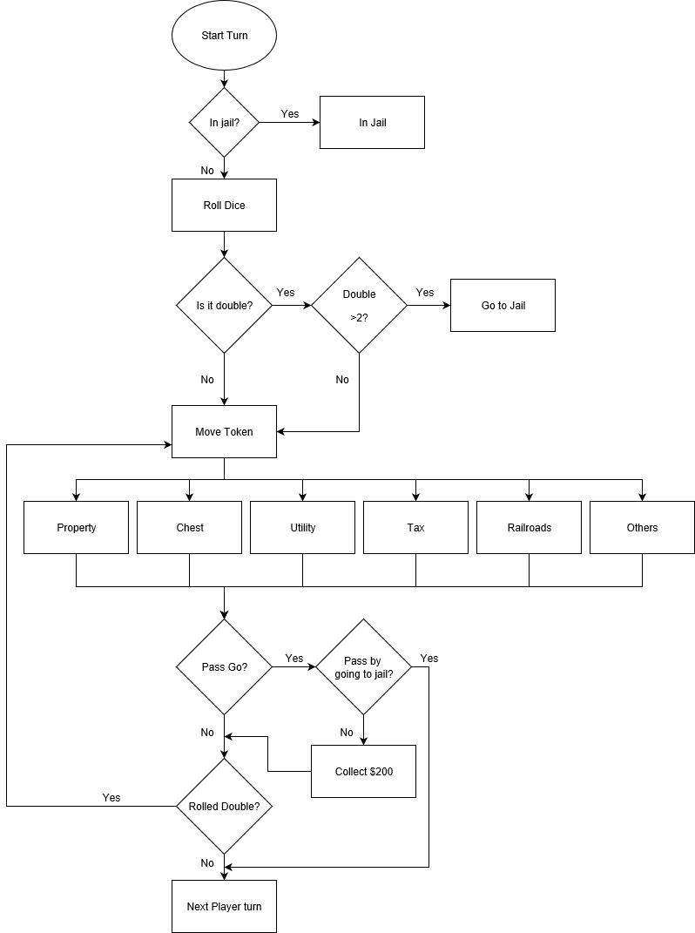
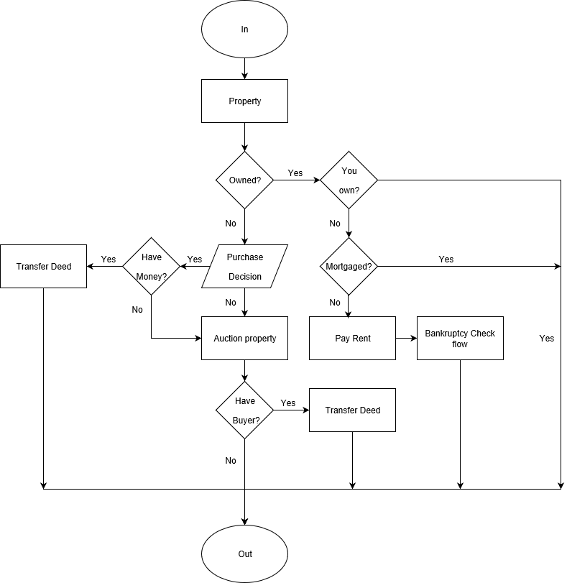
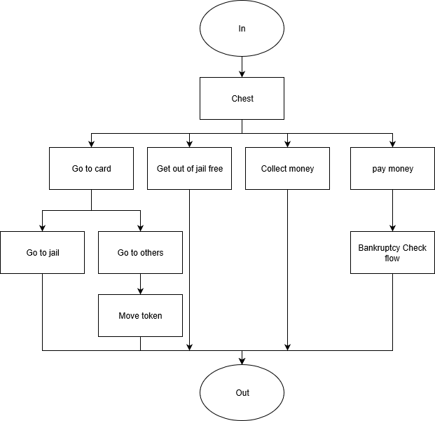
Script Development Process
Computation – Flow Charts

Slide 29
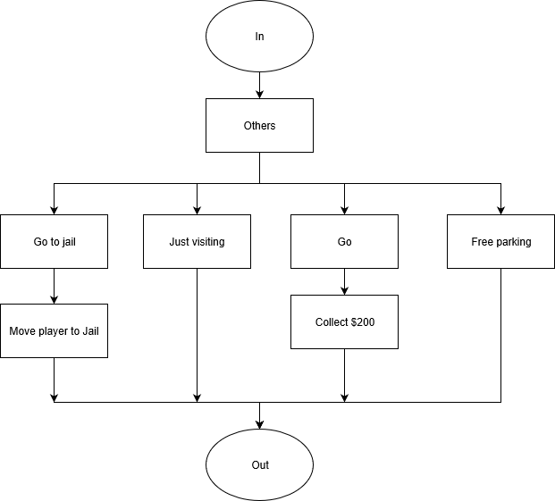
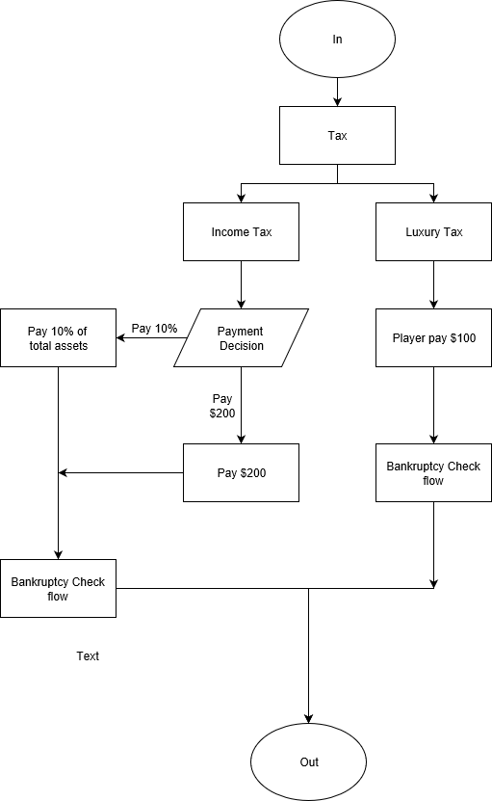
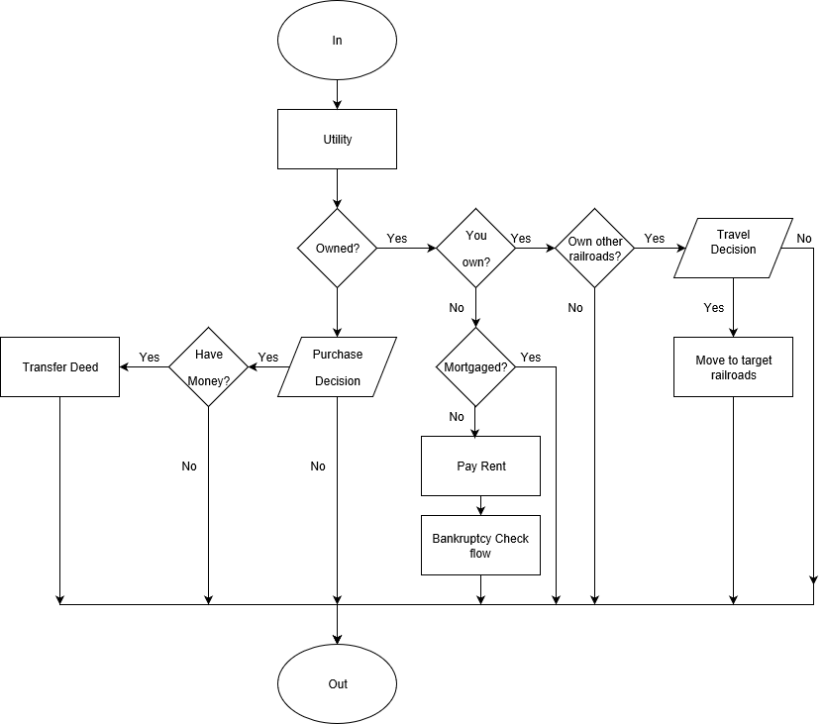
Script Development Process
Computation – A Lot of Flow Charts

Slide 30
Dynamo Master Class – Monopoly
Computational Geometry

Slide 31
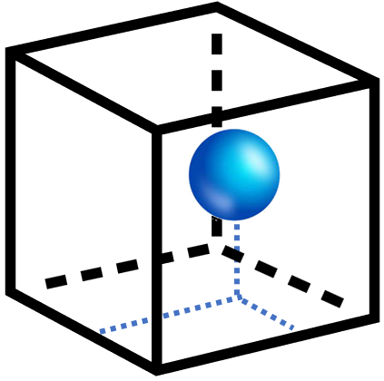
Computational Geometry
Room Contains Element

Slide 32

Computational Geometry
Shuffle and Stack Cards

Slide 33

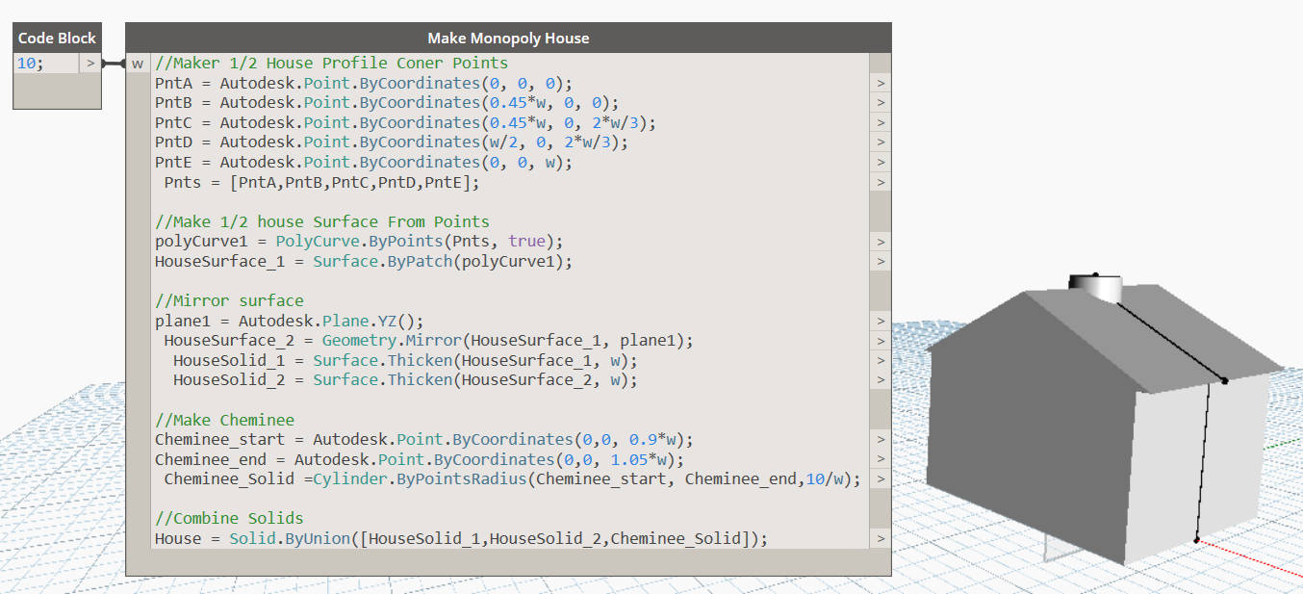
Computational Geometry
Building Geometry

Slide 34

Computational Geometry
Random Dice Locations

Slide 35
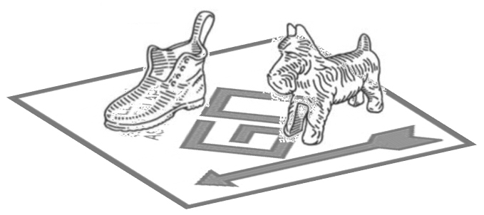
Computational Geometry
Place Tokens On Properties

Slide 36

Computational Geometry
Game Board Geometry

Slide 37

Computational Geometry
Place Tokens On Properties
P = [0, 0.2, 0.4, 0.6, 0.8, 1]
+ ½ House Width

Slide 38

Computational Geometry
TuneUp

Slide 39
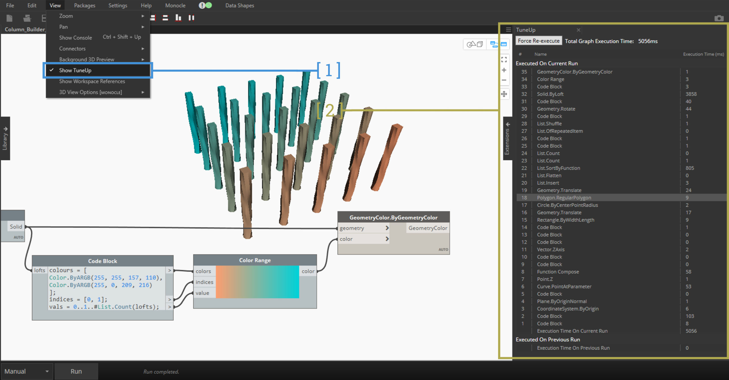
Computational Geometry
TuneUp

Slide 40
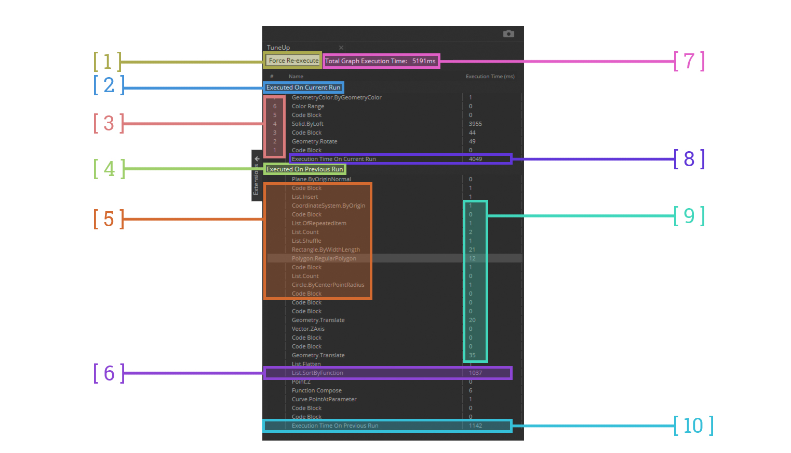
Computational Geometry
TuneUp

Slide 41




Dynamo Master Class – Monopoly
Dynamo & Revit

Slide 42
Dynamo and Revit
Collect Revit Elements

Slide 43
Dynamo and Revit
API Calls – Room at Point

Slide 44

Dynamo and Revit
Mesh to Revit Family

Slide 45
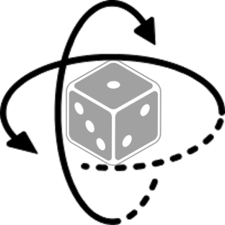
Dynamo and Revit
Rotate Dice Revit Family

Slide 46
Before the Coding
Generative Design – Card Shark
Variables
Objective
Could-Have
Won’t-Have
30 Card Position
Community Chest
0- 14
Chance
0- 16
VR support
Visual Effect
Online Multiplayer
Customizable game rules
Multiplayer support
Sound effects and music
Animation

Slide 47
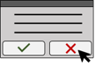
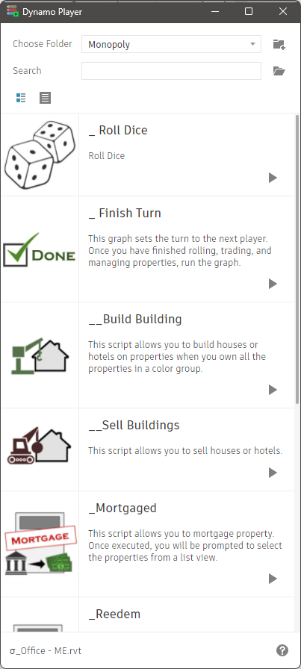
Dynamo Master Class – Monopoly
UI/UX

Slide 48
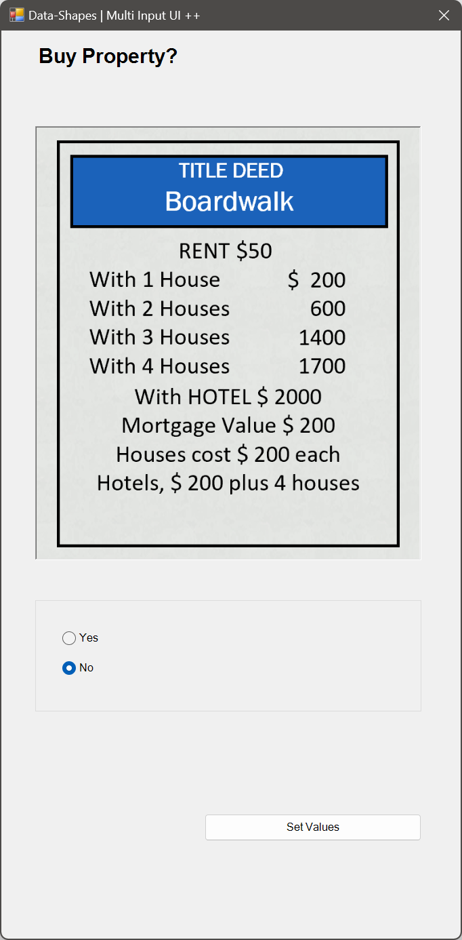
Dynamo Master Class – Monopoly
UI/UX

Slide 49

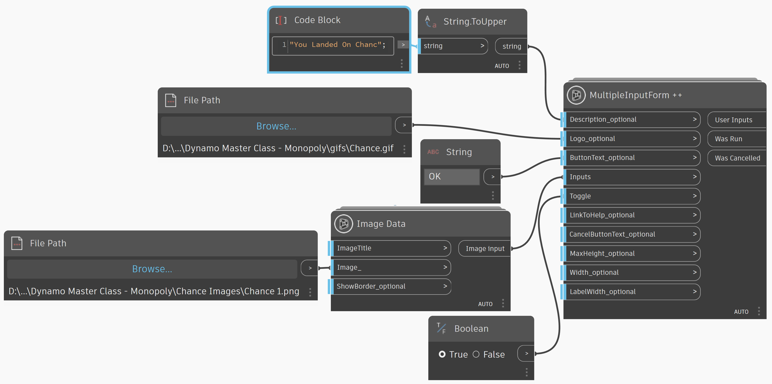
Dynamo Master Class – Monopoly
UI/UX

Slide 50

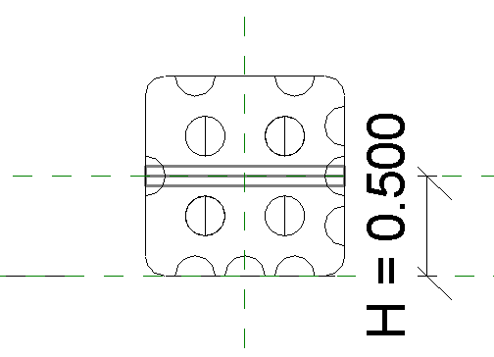
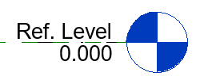
Dynamo Master Class – Monopoly
Chance Cards

Slide 51

Dynamo Master Class – Monopoly
Random Numbers

Slide 52
Dynamo Master Class – Monopoly
Random Numbers – Dice Numbers

Slide 53
Dynamo Master Class – Monopoly
Placing Houses on Properties
P = [0, 0.2, 0.4, 0.6, 0.8, 1]
+ ½ House Width

Slide 54
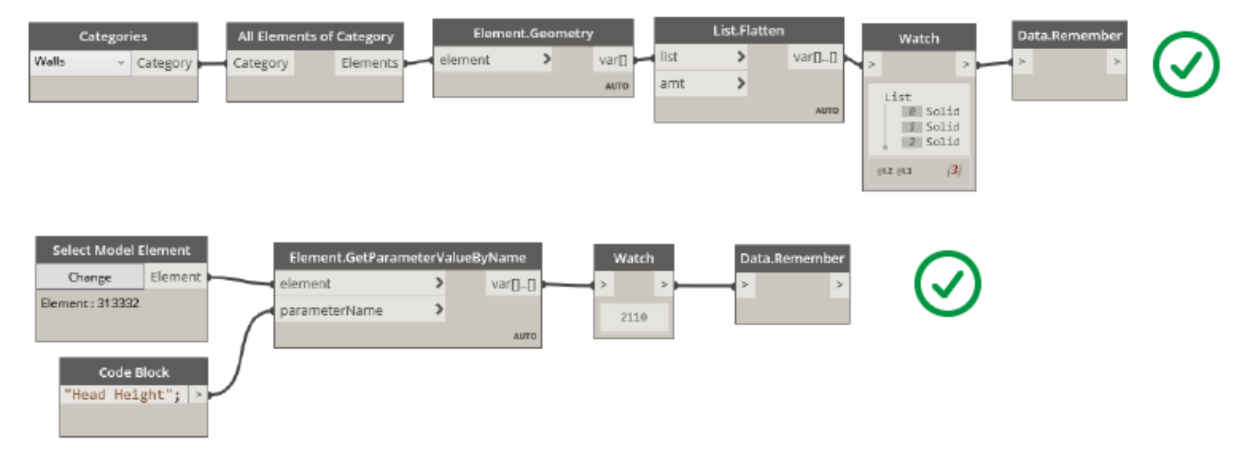
Dynamo Master Class – Monopoly
Data.Remember
Dice Surface
Points

Slide 55
Dynamo Master Class – Monopoly
Data.Remember
Notes:
Why - cache the results in the .dyn
Strings
Numbers
Solids
Points
Surfaces
'cannot store data of type'.

Slide 56
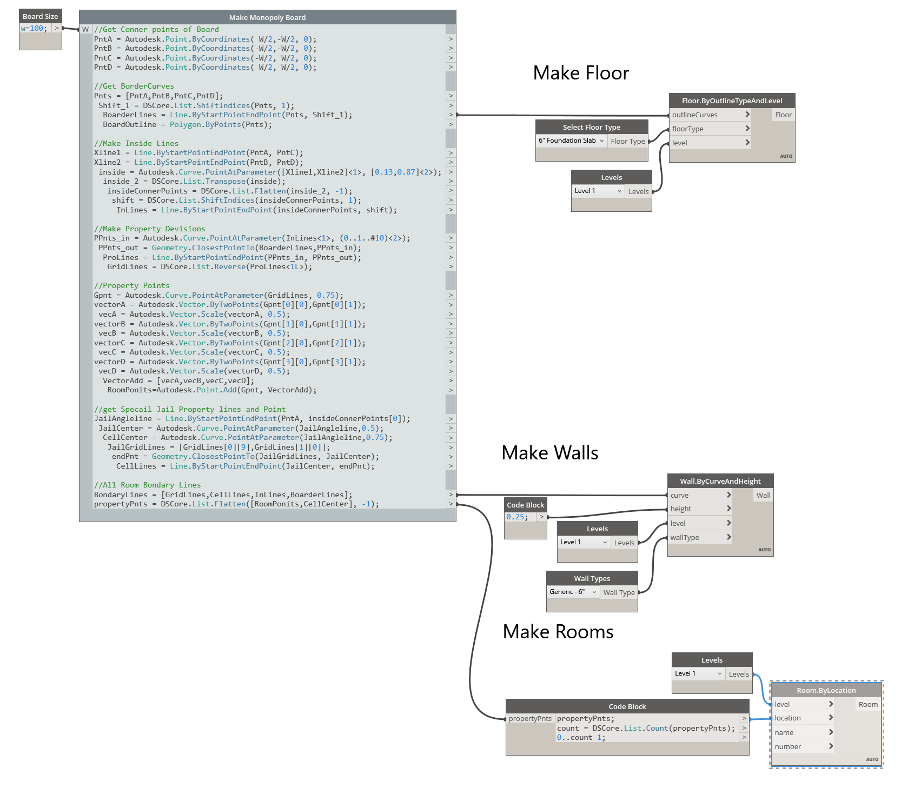
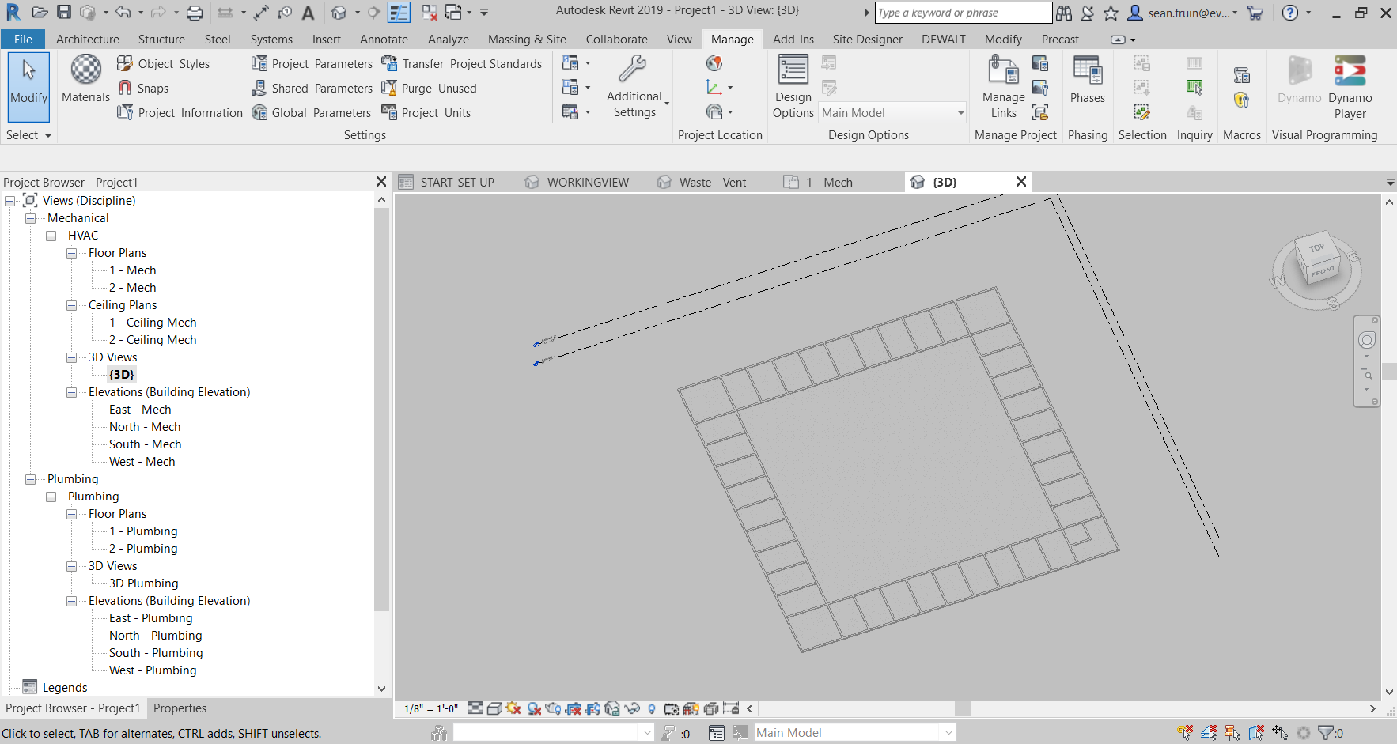
Dynamo Master Class – Monopoly
Data.Remember
Notes:
Why - cache the results in the .dyn
Strings
Numbers
Solids
Points
Surfaces
'cannot store data of type'.

Slide 57
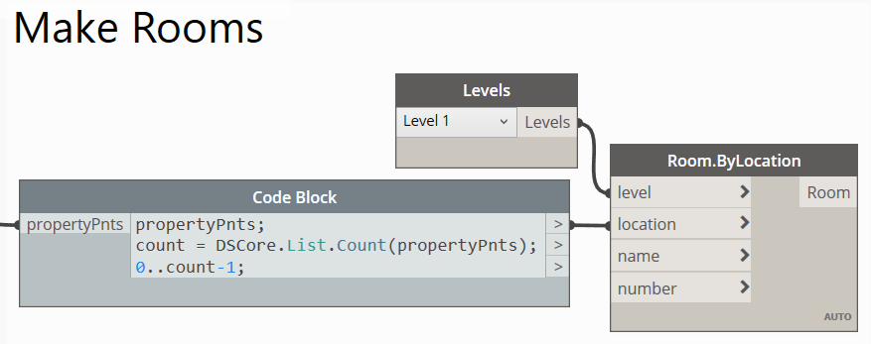
Dynamo Master Class – Monopoly
Data.Remember
Notes:
Why - cache the results in the .dyn
Strings
Numbers
Solids
Points
Surfaces
'cannot store data of type'.

Slide 58
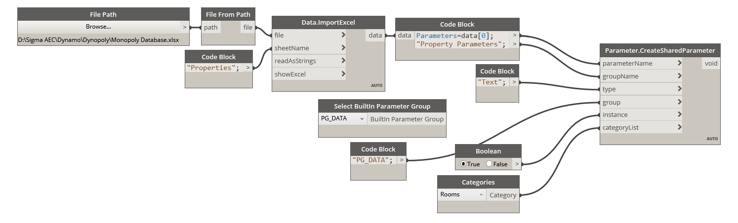
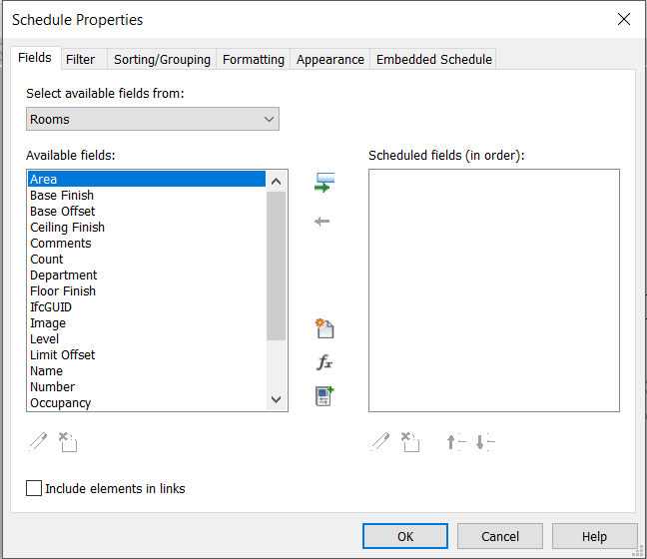
Dynamo Master Class – Monopoly
Data.Remember
Notes:
Why - cache the results in the .dyn
Strings
Numbers
Solids
Points
Surfaces
'cannot store data of type'.

Slide 59
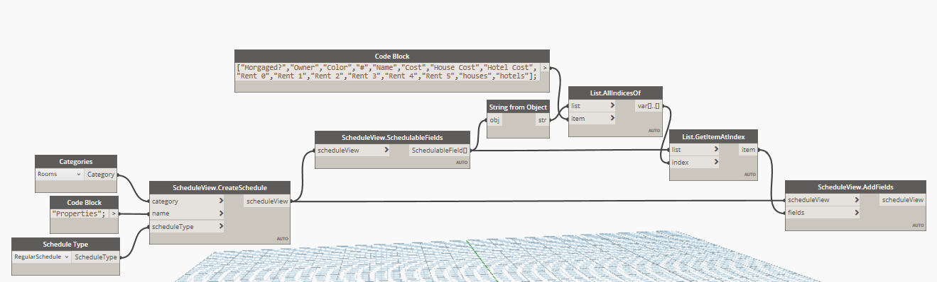
Dynamo Master Class – Monopoly
Data.Remember
Notes:
Why - cache the results in the .dyn
Strings
Numbers
Solids
Points
Surfaces
'cannot store data of type'.

Slide 60
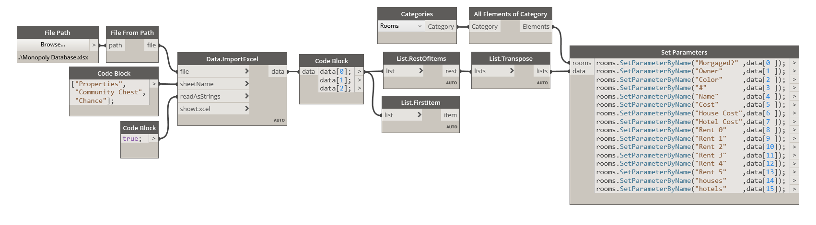
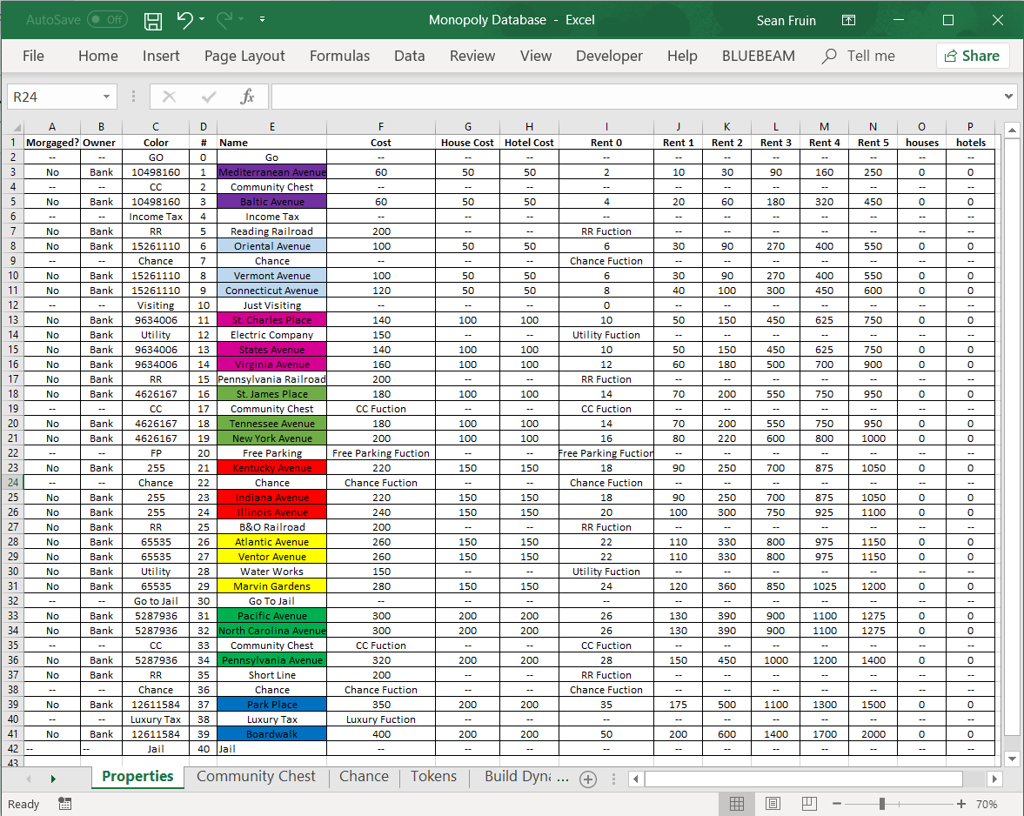
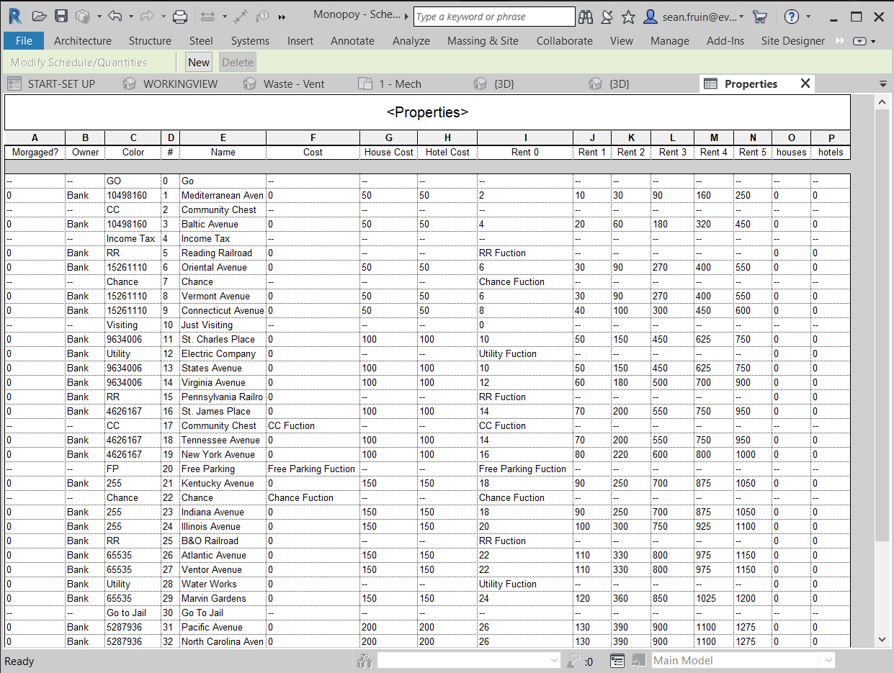
Dynamo Master Class – Monopoly
Data.Remember
Notes:
Why - cache the results in the .dyn
Strings
Numbers
Solids
Points
Surfaces
'cannot store data of type'.

Slide 61
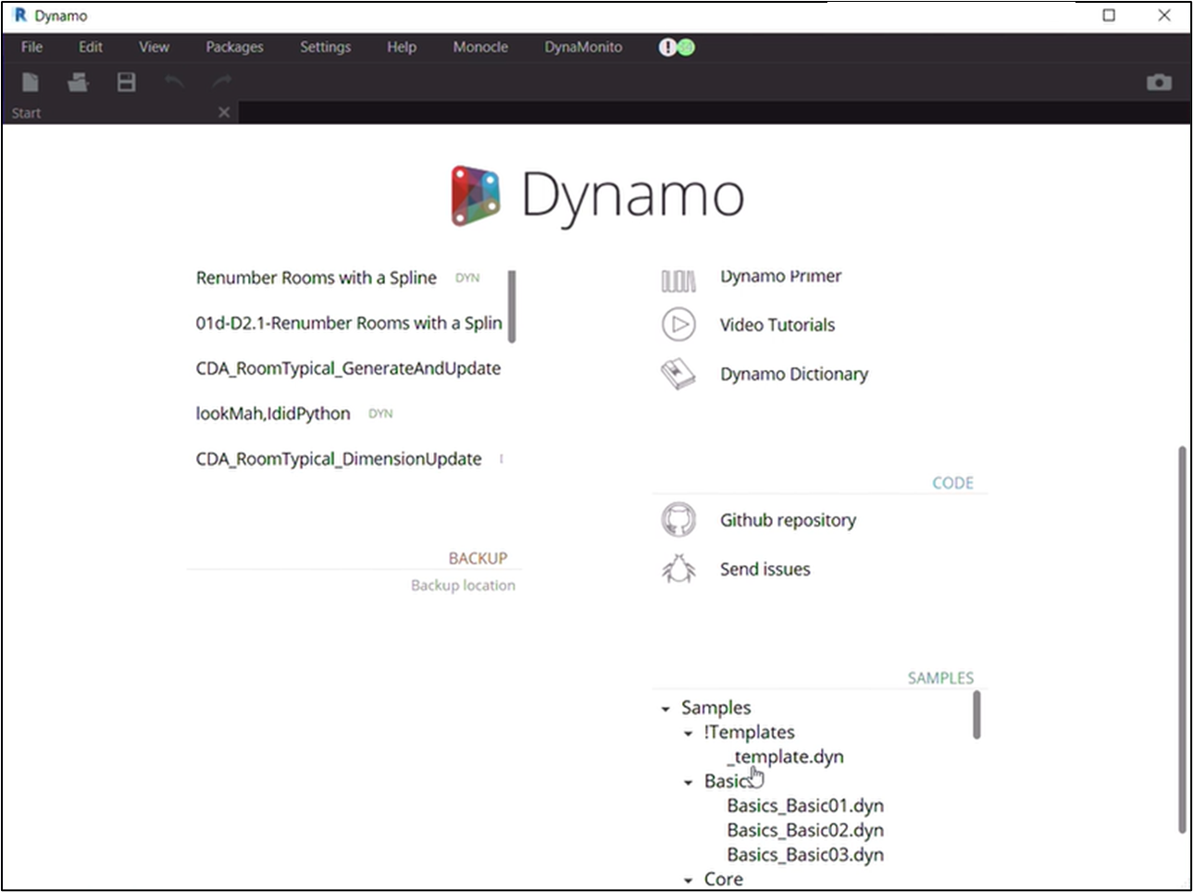
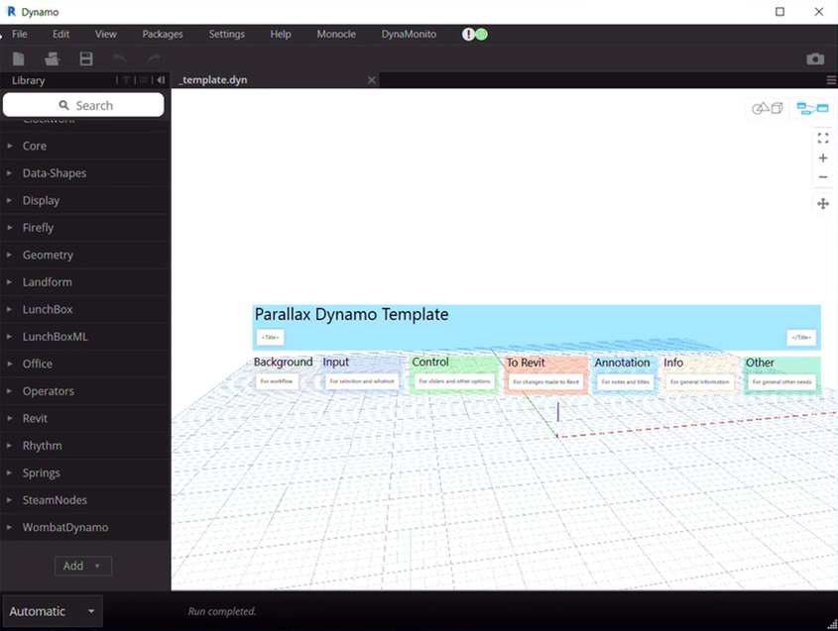
Dynamo Master Class – Monopoly
Template Script

Slide 62

Dynamo Master Class – Monopoly
Revit Rendering

